Slide 1
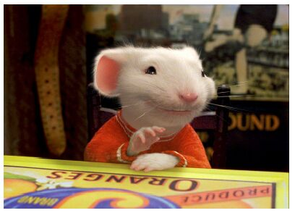
CSE- 4105
Lecture- 11
Color Models

Slide 2

COLOR MODELS FOR RASTER GRAPHICS
Three hardware-oriented color models are RGB (CRT
monitors), YIQ (broadcase TV color system), and CMY
(color-printing devices)
To related directly to intuitive color notions of hue,
saturation, and brightness, another class of models
(HSV, HLS, HVC, etc) are developed with ease of use
as a goal

Slide 3

Color Model
* What is the color?
Color is a sensation produced by the human eye and nervous system.
- It is related to light, but an understanding of the properties of light is not sufficient to understand color, and is especially not sufficient to understand the art of color reproduction.
‹#›

Slide 4
What is COLOR?
It is an attribute of objects (like texture, shape, smoothness, etc.)
It depends on:
1) spectral characteristics of the light source(s) (e.g., sunlight) illuminating the objects (relative spectral power distribution(s) SPD)
2) spectral properties of objects (reflectance)
3) spectral characteristics of the sensors of the imaging device (e.g., the human eye or a digital camera)

Slide 5
Primary and Secondary Color
Due to the different absorption curves of the cones, colors are seen as variable combinations of the so-called primary colors: red, green, and blue
Their wavelengths were standardized by the CIE in 1931: red=700 nm, green=546.1 nm, and blue=435.8 nm
The primary colors can be added to produce the secondary colors of light, magenta (R+B), cyan (G+B), and yellow (R+G)

Slide 6

Color Model
It is useful to represent a color by a set of exactly three numbers.
- In practice, the set of three numbers must be related to some actual color reproduction process. The numbers commonly specify portions of some set of primary colors such as:
‹#›

Slide 7
Color Model
* Color model.
A color model is an orderly system for creating a whole range of colors from a small set of primary colors.
In color reproduction, including computer graphics and photography, the gamut, or color gamut, is a certain complete subset of colors. The most common usage refers to the subset of colors which can be accurately represented in a given circumstance, such as within a given color space or by a certain output device.
Another sense, less frequently used but still correct, refers to the complete set of colors found within an image at a given time. In this context, digitizing a photograph, converting a digitized image to a different color space, or outputting it to a given medium using a certain output device generally alters its gamut, in the sense that some of the colors in the original are lost in the process.
‹#›

Slide 8
Color Model
A color model is an abstract mathematical model describing the way colors can be represented as tupples of numbers, typically as three or four values or color components.
Any method for explaining or behavior of color within some particular context is called a color model.

Slide 9
Different Color Models
Color Models
RGB (Red, Green, Blue)
CMY (Cyan, Magenta, Yellow)
HSI (Hue, Saturation, Intensity)
YIQ (Luminance, In phase, Quadrature)
YUV (Y' stands for the luma component (the brightness) and U and V are the chrominance (color) components )

Slide 10
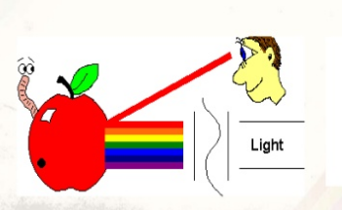
Properties of light
When white light is incident on an opaque object, some frequencies are reflected and some are absorbed.
The combination of frequencies present in the reflected light determines the color of the object that we see.

Slide 11
RGB Model
In this model, the primary colors are red, green, and blue. It is an additive model, in which colors are produced by adding components, with white having all colors present and black being the absence of any color.
This is the model used for active displays such as television and computer screens.
The RGB model is usually represented by a unit cube with one corner located at the origin of a three-dimensional color coordinate system, the axes being labeled R, G, B, and having a range of values [0, 1]. The origin (0, 0, 0) is considered black and the diagonally opposite corner (1, 1, 1) is called white. The line joining black to white represents a gray scale and has equal components of R, G, B.

Slide 12
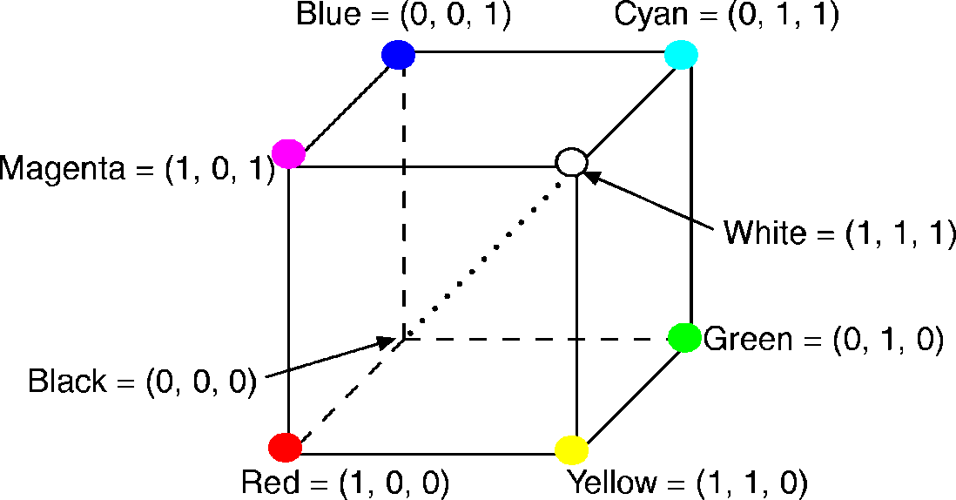
RGB Color Model
The RGB primaries are additive primaries.
The individual contributions of each primary are added together to yield the result.
Main diagonal => gray levels
black is (0, 0, 0)
white is (1, 1, 1)
The RGB cube (Grays on dotted main diagonal)
‹#›

Slide 13
The RGB color model (color CRT monitors)
the RGB primaries are additive primaries
Color: (R,G,B)
(0,0,1)=Blue
(0,1,1)=Cyan
(1,0,1)=Magenta
(1,1,1)=White
(0,0,0)=Black
(0,1,0)=Green
(1,0,0)=Red
(1,1,0)=Yellow
Diagonal of the cube, with equal amounts of each
primary, represents the gray levels from
black (0,0,0) to (1,1,1).
The color gamut covered by the RGB model is defined
by the chromaticities of a CRT’s phosphors.
Two CRTs with different phosphors will cover
different gamuts.
Copyright @ 2001 by Jim X. Chen: jchen@cs.gmu.edu

Slide 14
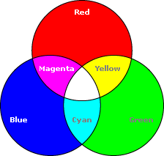
Color Model
* Types of Color model.
RGB Color Model:
* Additive color model.
* For computer displays.
* Uses light to display color.
* Colors result from transmitted light.
* Red + Green + Blue = White.
‹#›

Slide 15
Importance of RGB color model
The color model RGB is used in hardware applications like PC monitors, cameras and scanners.
It is used for Web graphics, but it cannot be used for print production.
It directly reflects the physical properties of “True-color” displays.

Slide 16
Importance of RGB color model
It is used—
For sensory representation.
Display of text images in electronic system, For example- computer, TV, camera.

Slide 17
Why RGB is better
RGB is really a better way to go for many reasons. Conversion from one color space to another can sometimes be problematic for companies that have a limited knowledge of color management. But in this time of automated color-managed workflows, the resistance to RGB makes little sense from a production point of view. And the pros of RGB generally are stronger than the cons.

Slide 18
Why RGB is better
The most compelling reason to adopt an RGB workflow is to increase the print provider’s ability to "match the original"-the RGB color space simply allows for a wider range of colors. While it’s true that no output device can match the color range of a transparency or digital camera, modern wide-format devices offer a much wider color gamut than traditional offset presses. In many cases, it makes perfect sense for each print job to try to get the maximum color space your device is capable of reproducing. Clearly, the more data you input to the device, the more you can output.

Slide 19
Why RGB is better
CMYK conversion, by definition, reduces the data contained in the original RGB image. And data that is thrown away can never be reclaimed-it’s gone for good. To retain as much data as possible, there is a growing trend toward performing color conversion only in the final rasterizetion process before printing. That way, all of the data in the image file is retained.

Slide 20
CMY Color Model
Relations between RGB and CMY
The unit column vector is the RGB representation for white and the CMY representation for black.
Green
Yellow
(minus blue)
⎡
C
⎤
⎡
1
⎤
⎡
R
⎤
⎢
M
⎥
=
⎢
1
⎥
−
⎢
G
⎥
⎢
⎥
⎢
⎥
⎢
⎥
⎢
Y
⎥
⎢
1
⎥
⎢
B
⎥
(minus red)
Cyan
⎣
⎦
⎣
⎦
⎣
⎦
Black
Red
Blue
Magenta
(minus green)
‹#›

Slide 21
CMY Color Model
Another color model, CMYK, uses black as a fourth color.
Given a CMY specification, black is used in place of equal amounts of C, M, and Y, according to the relations:
K:=min(C,M,Y)
C:= C – K
M:= M – K
Y:= Y - K
‹#›

Slide 22

The CMY color model (ink-jet plotters)
CMY are the complements of RGB. When used
as filters to subtract color from white light, they
are called subtractive primaries.
Colors are specified by what is removed or
subtracted from white light, rather than by
what is added to blackness.
Cyan = RGB - R
Magenta = RGB - G
Yellow = GRB - B
From white (paper) by adding CMY, we can
generate all different colors.
Use CMYK K=black instead of just CMY.

Slide 23
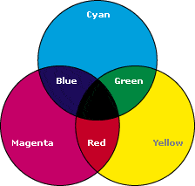
Color Model
* Types of Color model.
2) CMYK Color Model:
* Subtractive color model.
* For printed material.
* Uses ink to display color.
* Colors result from reflected light.
* Cyan + Magenta + Yellow = Black.
‹#›

Slide 24
Color Model
the color model RGB is used in hardware applications like PC monitors, cameras and scanners, the CMY color model is used in color printers,
Each color can be a point in the RGB color model cube. Red, green and blue are known as the primary colors. These colors can be added to produce secondary colors which are:
magenta = red + blue
cyan = green +blue
yellow = red + green
Other possible combinations:
white = blue (primary) + yellow (secondary)
white = green (primary) + magenta (secondary)
white = red (primary) + cyan (secondary)
‹#›

Slide 25
Importance of cymk color model
The CMY color model is used in color printers.
It is created by the subtractive mode
Used in most commercial color printing (Books, Magazines etc.).

Slide 26
Advantages of CMYK technique
1) Less color process / screen for print.
2) More productivity.
3) Cost minimizing.
4) Good hand feel because of using less color on ground.
5) CMYK color can be used for different item of print because of common color way.

Slide 27
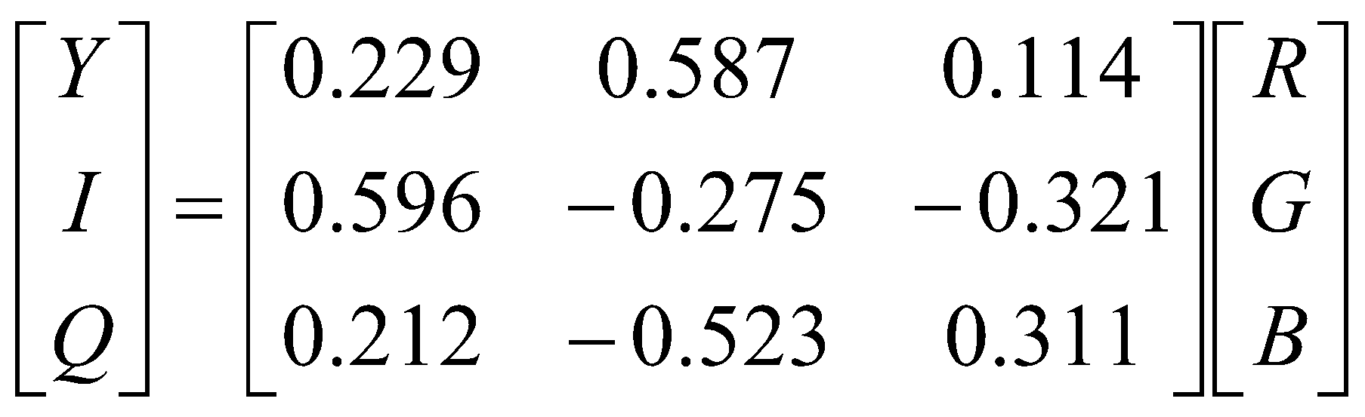
The YIQ color model (US color TV broadcasting)
a recording of RGB for transmission efficiency
and for downward compatibility with black
and white television.
Here Y=luminance, the same as the CIE Y
primary. Only the Y component of a color TV
signal is shown on black-and-white TVs.
More bits of bandwidth are used to represent Y than
to represent I and Q, because our eye is more sensitive
to changes in luminance

